Slide 1

AI powered Emotion Recognition: From Inception to Production
Vandana Kannan
Naveen Swamy
Software Engineer
Amazon AI
Senior Software Engineer
Amazon AI
*
Notes:
Hello, thank you for joining us today. My name is Vandana Kannan, I am a Software Developer at Amazon and I work on Deep Learning frameworks & tools specifically Apache MXNet.

Slide 2
Outline
Introduction to Deep Learning
Convolutional Neural Network (CNN)
Apache MXNet & Amazon SageMaker
MXNet Model Server (MMS)
Notes:
Today I am going to briefly introduce you to Deep Learning,
Deep Learning for Computer Vision
I will then introduce you to Apache MXNet DL framework
Lastly Deep Learning Inference.
So Lets get started

Slide 3

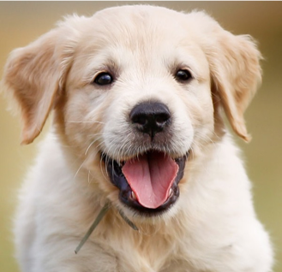
Deep Learning
CAR
DOG
Output
(object identity)
PERSON
3rd hidden layer
(object parts)
Originally inspired by human biological neural systems.
A system that learns important features from experience.
Layers of neurons learning concepts.
Deep learning != deep understanding
2nd hidden layer
(corners & contours)
1st hidden layer
(edges)
Input layer
(Raw pixels)
Source: Ian Goodfellow etal., Deep Learning Book
Notes:
Let me start out by asking how many of you know the difference between ML & Deep Learning?
Like you all know Machine Learning is about using algorithms to learn patterns from raw data and make decisions.
In traditional ML, before you could use a Algorithm, you had to go through a step called Feature extraction where you carefully handcrafted the salient features of your data, this had some drawbacks from requiring domain expert, being error-prone and it did not work for new problems.
Deep Learning or Neural Networks solves these problems differently. The term Deep Learning or Neural Networks is used Interchangeably
The area of neural network design was originally inspired by how learning happens in our brain. Today it has diverged to become more of a engineering and algorithm challenge to solve various ML tasks.
In this system, the most important features are learnt by itself from experience. It understands in terms of hierarchy of concepts building one concept at a time.
Lets take an example of Image classification task where the objective is given an image, to find the most prominent object in the image from a predefined set of classes.
Consider this network of many layers, which can classify images into 3 different categories.
First, you have an input layer to which you feed the input raw pixels.
and then there is the first hidden layer which tries to learn edges by looking at the brightness of the neighboring pixels.
The layers between input and output are called hidden layers because the values are not given in the data and the network should learn values that are required to explain the relationship.
the 2nd hidden layer is extracting corners and contours.
3rd hidden layer learning object parts in the image
and finally the output layer tells you what object it is from the predefined set of classes. Here we have 3 classes and we get confidence score for each of them. For the output dog we would get a higher probability score.
It is important to note that the word deep in Deep Learning is not to mean that the system is gaining deeper understanding, rather to say that the number of layers is very large. The number of layers in the network is also called depth of the Network

Slide 4
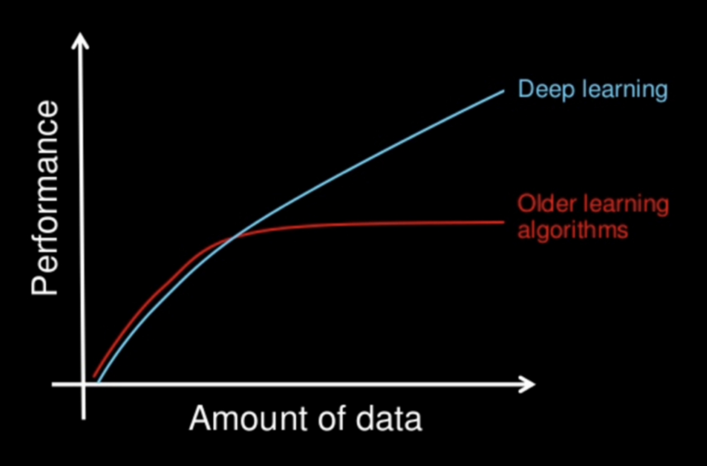
How is Deep Learning Different from Machine Learning
Automated feature learning
Requires lots of labeled data
Gets better with more data
Computationally intensive
Generic architecture
Credits: Sandeep Krishnamurthy
Notes:
So, how is Deep Learning different from Machine Learning? Why does it deserve a category of its own?
There’s a few key ways in how DL is different than other ML techniques.
Automated feature learning – with ML, when you go about solving a problem, you need to identify the important features, write the code to extract these features, and then feed it to the learning algorithm. In problems with high dimensionality, this is very difficult to do, is very time consuming, and tend to not transfer well between domains. With DL, this is mostly not needed - the neural network takes care of identifying the features itself – which greatly simplifies the work for us humans.
Data – DL tends to require lots of data, typically much more than other ML techniques. ImageNet, as an example, is a database with labeled images, used for training vision models such as image classification. It consists of more than 14M images. What is even more interesting, is that DL tends to work better the more data you feed in for training. This is different than most other ML techniques that do not improve further.
Computationally Intensive – DL is very intensive for training but also for inference. Training a modern network can take days or even weeks, depending on the size of the model. One feed forward through a modern DNN can take billions of FLOPs Generic Architecture – DL, or more specifically DNN, have an architecture that works effectively across different problem domains such as Vision, NLP and more.

Slide 5
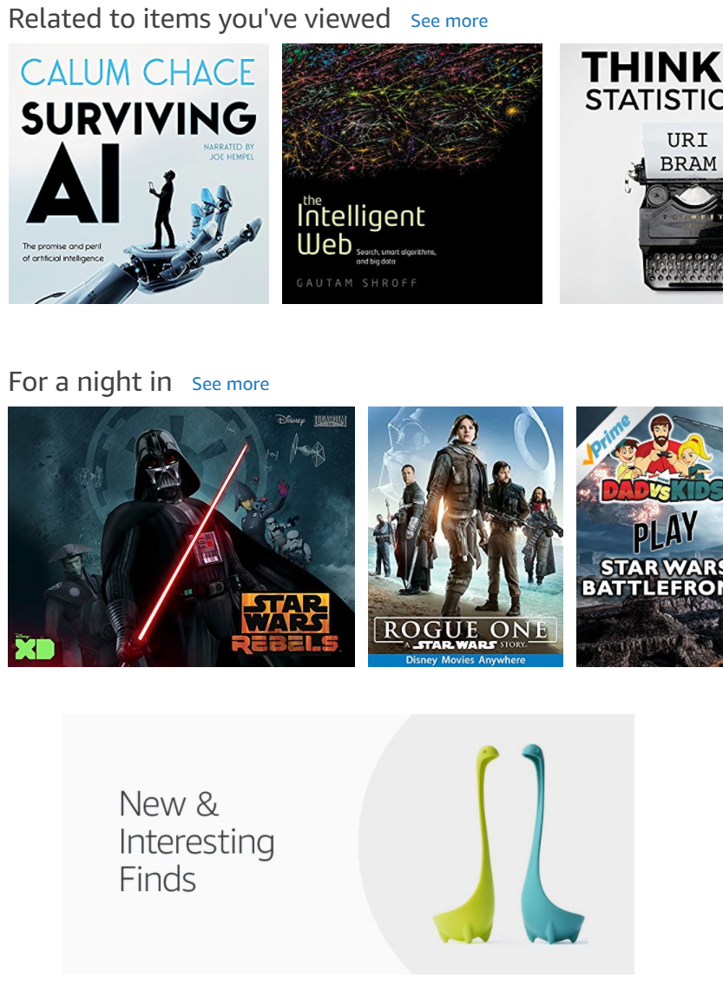
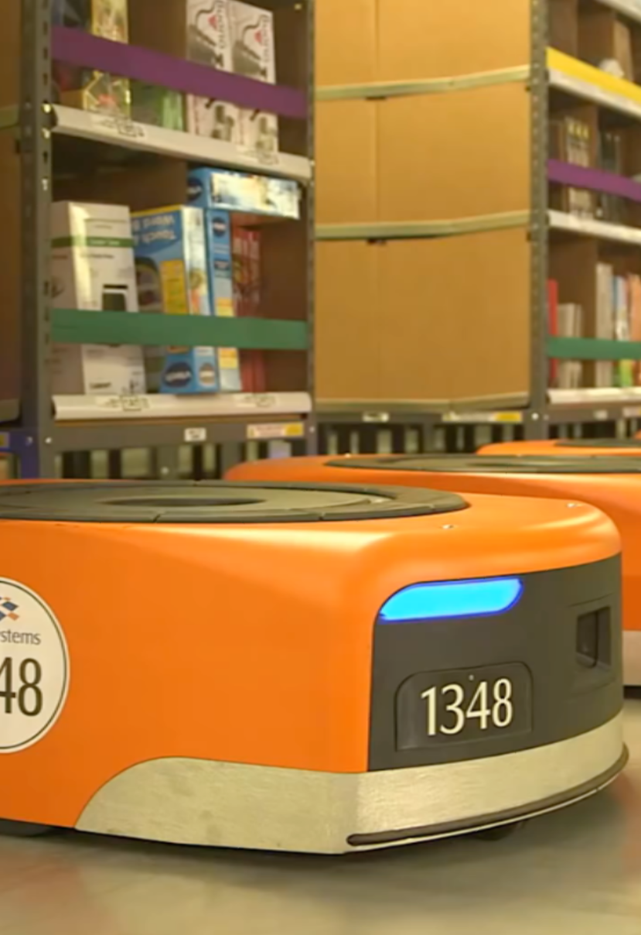
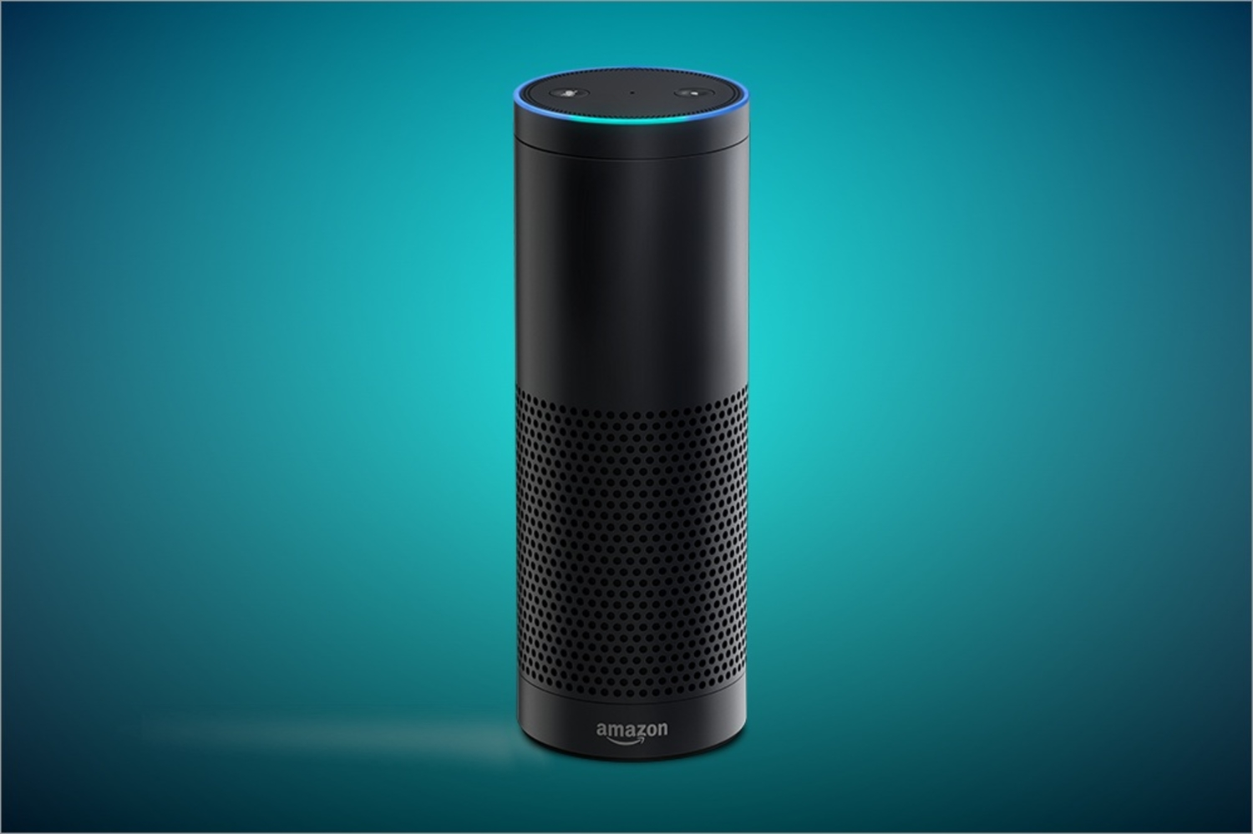
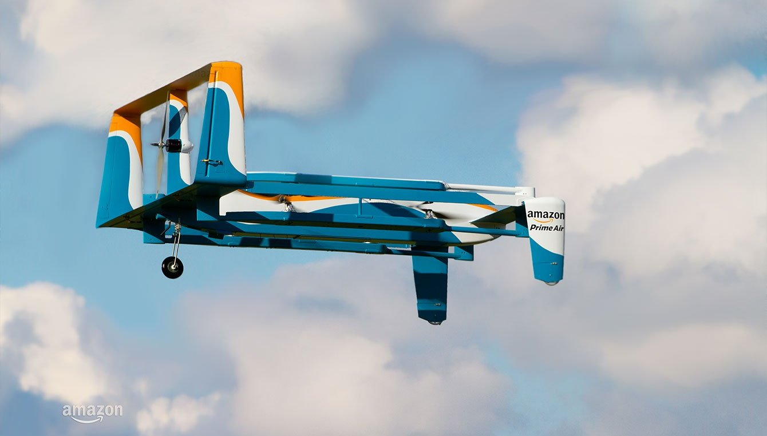
Deep Learning is a Big Deal
It has a growing impact on our lives
Personalization
Robotics
Voice
Autonomous Vehicles
Credits: Hagay Lupesko

Slide 6
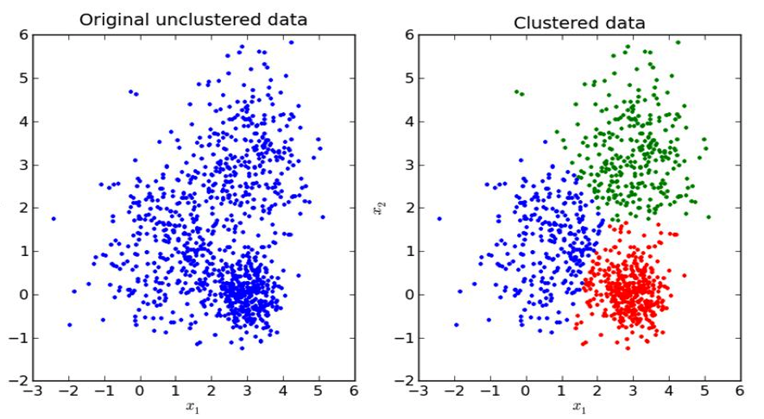
Types of Learning
Supervised Learning – Uses labeled training data to associate input data to output.
Classification: Output is discrete categories
Regression: Output is a continuous value
Example: Image classification, Speech Recognition, Machine translation
Unsupervised Learning - Learns patterns from Unlabeled data.
Example: Clustering, Association discovery.
Active Learning – Semi-supervised, human in the middle..
Reinforcement Learning – learn from environment, using rewards and feedback.
Notes:
Lets look at some popular types of Learning in Neural Networks.
Supervised learning, you tell the computer program what semantic content is contained in your data, often thousands of input at a time. For example here is an image and it contains a `dog`
Applications that are leveraging include Image classification, Speech Recognition, Machine translation.
Unsupervised Learning, We try to make sense of the unlabeled data and get information from it.
Example: Clustering, Association discovery. You could use Clustering to do topic modeling on a corpus of text data.
Active Learning is a semi-supervised learning technique that uses a human in the middle of the pipeline. There is lots of unlabeled data, this system tries to learn concepts from this data and when uncertain it queries users for labels.
Reinforcement learning where the system or an agent is learning based on the experiences in its current environment through the use of rewards and feedback.

Slide 7
Steps in Training
training loop
pre-process
data
define
neural network
define
loss function
feed a batch of data
measure training accuracy and loss
validate model
update weights
W = W + 𝞭W
find gradients
loss & optimization
backprop
Notes:
Lets look at how to train a neural network, invariably there is some form of data pre-processing required. one of them is normalizing your data so no one input has undue influence on the weights learnt, we do this by centering data and subtracting the mean of the input from every input.
Next we will define the neural network, earlier we saw MLP with hidden layers. Number of layers and number of units in each layer are hyper-parameters.
We will define a loss function that measures the difference between the scores produced by the model and ground truth value.
We split the training data into batches, Next feed a batch of data from the input data set, we evaluate the training accuracy – calculate as a percentage how close the predictions are to ground truth.
We also separately validate our learned parameters against a validation dataset. The validation dataset is different from Test dataset, we don’t want to touch the test dataset during training and is considered precious since we don’t want to the parameters to be influenced by the test dataset, we want the parameters that are generalized and can work on a wide variety of input.
We create a Validation dataset by using 10% or 20% of the training data.
then we calculate the loss, apply optimizer to find gradients and finally update the weights. We do this for all the batches of input. We’ll see the details in a minute.
We continue to run this loop for many iterations until our accuracy objective is met, an iteration is also called a epoch.

Slide 8

Optimization
find parameters that minimize the loss function
Gradient Descent: Iteratively update parameters to get the most optimal value for the objective function
Notes:
Optimization is the process of finding parameters minimizing the loss function.
A naïve way to minimize loss function would be by
Random Search: We could try out many different parameters by randomly picking weights and keeping track which set of weights produces the least loss. This requires a lot of tries to even get a decent accuracy.
The popular analogy used to describe is the Blindfolded hiker who is on the hill and trying to get to the bottom of the hill. Here the hiker would take a random step and see if that is taking him down.
Another approach is to extend one foot randomly and take the step only if its leading downhill.
We start with random Weights and generate deltas and compute the loss and update the weights only if the new weights produce lower loss. This is slightly better.
Improving a set of weights is easy to do iteratively rather than find the best weights.
There is a better and mathematically guaranteed way to find the steepest descend along which we can change the weights. This is the gradient of the loss function. gradient is the derivatives of vector of numbers.
In the hiker analogy we feel the slope of the hill before taking the step.
---
finding best set of weights is very difficult or even impossible
less difficult to improve a particular set of weights.
use gradient of the loss function to update our weights which will minimize the loss.

Slide 9
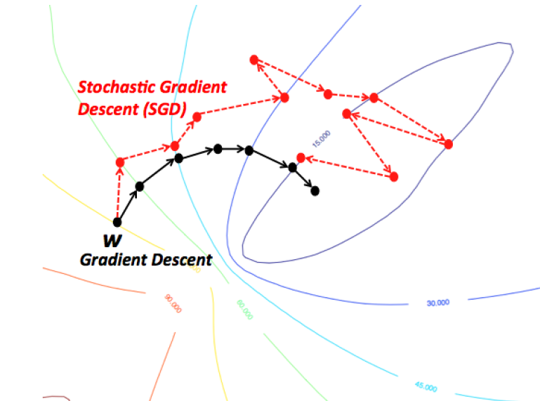
Stochastic Gradient descent
A single iteration for the parameter update runs through a BATCH of the training data
while True:
data_batch = sample_training_data(data, batch_size)
weights_grad = evaluate_gradient(loss_fun, data_batch, weights)
weights += - step_size * weights_grad
Notes:
Training data often contains millions of data, its expensive and wasteful to compute loss through all the data just to make a single parameter update, instead in Stochastic gradient descent we take batches of data and compute the gradient. This is more effective and efficient since we can vectorize these operations especially with GPUs to yield us faster learning.

Slide 10
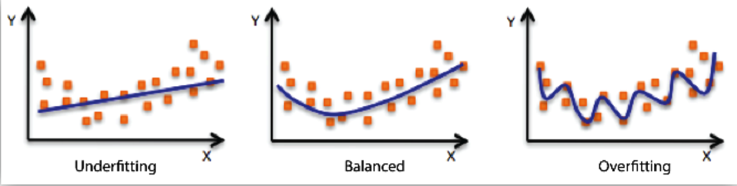
Overfitting/Underfitting
Underfitting: model performs bad on training data
Adding new features, increase feature cartesian product – nth degree polynomial , reduce regularization.
Overfitting: the model performs well on the training data but does not perform well on the validation data.
Use Regularization
Notes:
W is not unique that can correctly classify every example.
The model underfits when it cannot capture the underlying relationship in the data, this is when the model is too simple model, generally has low varience and high bias
We fix this by Adding new features, increase feature cartesian product giving a nth degree polynomial and also by reducing regularization
Overfitting: Performs better on Training data but not evaluation data, the model has not generalized and is memorizing the data it has seen and is unable to generalize to unseen examples. This happens when the model is too large and starts capturing the noise in the data.
Number of parameters is large.
Model parameters can take a wide range of values
Training Dataset is small.
We solve this by adding Regularization.

Slide 11

Dropout
keeping a neuron active with some probability p
forces learning by all neurons.
dropout is only applied during training and not at test.
Srivastava, Nitish, et al. ”Dropout: a simple way to prevent neural networks from
overfitting”, JMLR 2014
Notes:
Dropout is a type of regularization implemented by keeping a neuron active with some probability p,
We only update the parameters of the sampled network based on the input data.

Slide 12
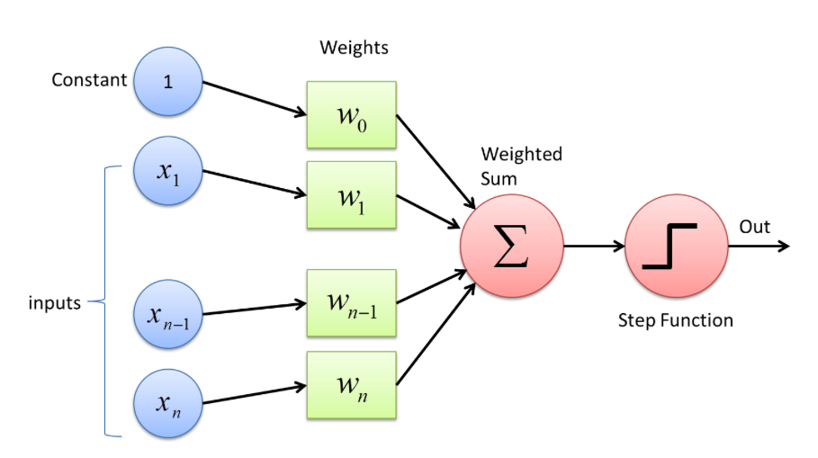
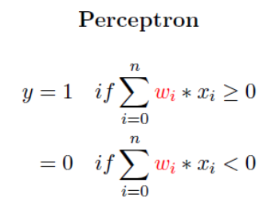
Perceptron
Notes:
Now we’ll look at the internals of a neural network by starting with the most simple neural network.
A single layer neural network
Consists of 4 parts:
Input values
Weights and Bias
Net sum
Activation Function
Steps of execution:
Multiply inputs x with weights w
Add all the multiplied values - weighted sum
Apply unit step activation function to the weighted sum
Real-world applications cant be solved with this simple NN – given that data is large, more features, more complex result.

Slide 13
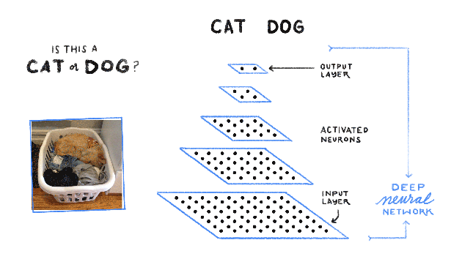
Multi-layer perceptron
Reference
Notes:
Therefore we have the MLP.
Multiple layers transform data differently, learning features in an attempt to get a result that will answer the question at hand.
At every layer, a dot product of inputs and weights is computed, followed by an activation function to pass on learnings through the network.
This seems like a good generic solution that can be applied to all applications, but that isn’t the case.
Layers: Input Layer, Hidden Layer, Output Layer and more.
Dense Layers: Fully (Densely) Connected to adjacent layers.
Everything is dot product of N Dimensional Arrays (NDArray).
Activation Function: A computation that acts as a switch to turn ON/OFF a neuron.

Slide 14
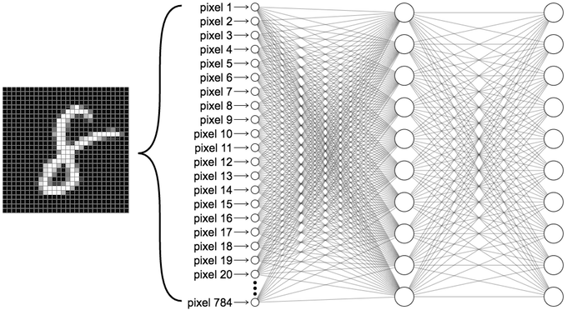
Why not MLP?
28 X 28 image is flattened to 784 pixels Array
784 X 784 is number of parameters (weights) in first hidden layer. 614,656
Number of parameters to learn is huge
Therefore, CNN!!
Credits: Sandeep Krishnamurthy
Notes:
we need to discard the input image's original shape and flatten it as a vector before we can feed it as input to the MLP's first fully connected layer. Turns out this is an important issue because we don't take advantage of the fact that pixels in the image have natural spatial correlation along the horizontal and vertical axes.
And the number of params increases because of the way data is represented.
A convolutional neural network (CNN) aims to address this problem by using a more structured weight representation. Instead of flattening the image and doing a simple matrix-matrix multiplication, it employs one or more convolutional layers that each performs a 2-D convolution on the input image.

Slide 15
Basic CNN architecture
MLP
v/s
CNN
Source: CS231n
Source
Notes:
In summary, if we compare the architecture of the MLP and CNN, we can say that the CNN arranges its neurons in three dimensions (width, height, depth), as visualized in one of the layers. Every layer of a ConvNet transforms the 3D input volume to a 3D output volume of neuron activations.

Slide 16
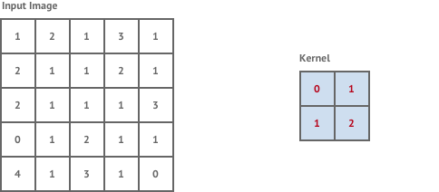
CNN Building Blocks - Kernel
Input image is an NDArray
Filter (Kernel): Another smaller NDArray. Moved across the image. Multiply elementwise and take the sum
Feature Map: Output of moving a Kernel across the image
Kernel is learnt: Network changes the values for the Kernel and see what works best. This is called training (learning)
67\
Notes:
Kernel is like a filter that pass through the image and capture the features. Basically, Moving a Kernel on the image gives the featuremap

Slide 17
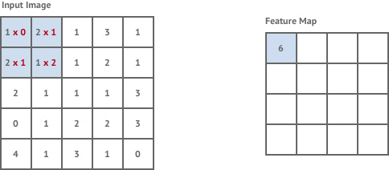
CNN Building Blocks - Convolution
You are seeing a piece of image
together at once (Spatial information)
Multiple Kernels (filters)
(Edges, Curves, a Color etc...)

Slide 18
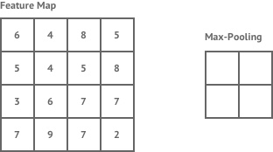
CNN Building Blocks - Pooling
More the parameters, more time to learn, more complex it is
Take a representative from a group i.e., pool the candidates and take a representative
Types: Max Pooling, Avg Pooling, Min Pooling and more…
Max Pooling is commonly used technique
69

Slide 19
Apache MXNet - Background
Apache (incubating) open source project
Framework for building and training DNNs
Created by academia (CMU and UW)
Adopted by AWS as DNN framework of choice, Nov 2016
https://mxnet.incubator.apache.org/
Notes:
Just a bit of background on MXNet:
It is an Apache open source project. People sometimes think it is an “Amazon Project” but it is not. It is truly open source, decisions are made by the community. However, it is true that AWS is contributing a lot to the project.
It is a framework for building, training and using DNNs for inference. Similar to TF, PyTorch, etc.
It originated in the adademia, CMU and UW
Aws adopted MXNet late 2016 as “DL FW of choice), there’s a nice blog post by AWS CTO (Vogels) explaining more in details. A lot of it is about scalability and MXNet being good for production use.

Slide 20
Multi-language Support
R
Perl
Julia
Clojure
Python
Java
Scala
C++
Frontend
While keeping high performance from efficient backend
Backend
C++
Notes:
Having said this, majority of model training happens with Python. I recommend Python for model training.
For inference and production deployment of models, you can choose the language binding based on your production setup, latency/memory and other technical requirements.
For example, Using Scala for inference is highly requested feature by large enterprise users of MXNet because, they usually have a JVM based software stack in production servers.
C++, is used for low latency requirements.
With these supports, MXNet is definitely one of the top deep learning framework with production support.

Slide 21
Apache MXNet Ecosystem
ONNX
TVM
Model Zoo
TensorRT
GluonCV
Model Server
GluonNLP
MXBoard
eras
Notes:
There are many interesting and useful projects being built with and around MXNet.
These ecosystem or related projects will be useful as you become more and more power user.
For example, GluonCV, GluonNLP are toolkits with implementations of state of the art algorithms and you can just use it out of the box.
Be assured, some of these projects will be very useful as you start using deep learning in your projects
Model Zoo (Module, Gluon & ONNX)

Slide 22

















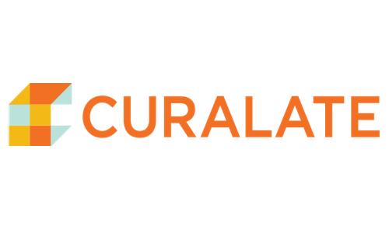









Apache MXNet Customer Momentum
Notes:
Use customer references verbally
Customers that chose MXNet due to multi-GPU training support and high scalability.
Curalate, TuSimple, Borealis AI, NTT Docomo
Designed to be easily wrapped by other languages
Wolfram integrated MXNet as the backend of Mathematica for building NN
Curalate is using Scala inference API
We have an enterprise customers who is running 100+ MXNet – Gluon models in production for product recommendation across 26M+ user base

Slide 23
Amazon SageMaker
A fully-managed platform that provides a quick and easy way to get models from idea to production.
https://aws.amazon.com/sagemaker/
Notes:
So what is SageMaker, in a nut shell?
It is a fully managed platform, that makes it super easy and fast to develop your models from abstract ideas up to production.
Let’s look at what this means.

Slide 24
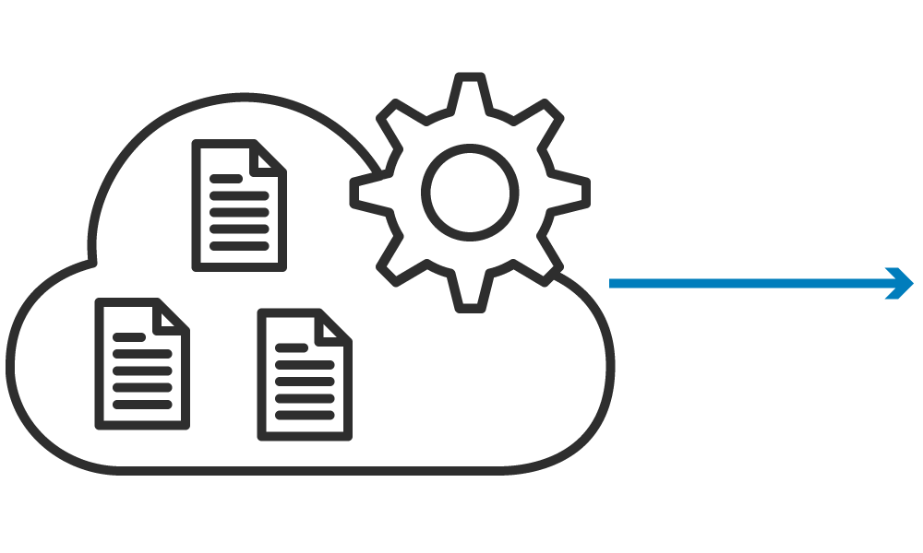
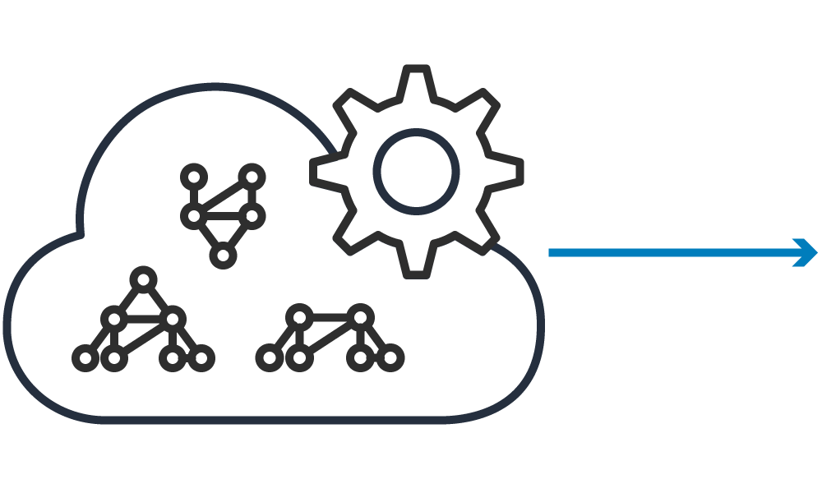

Amazon SageMaker Workflow
Building
Training
Hosting
Amazon’s fast, scalable algorithms
Distributed TensorFlow, Apache MXNet, Chainer, PyTorch
Bring your own algorithm
Hyperparameter Tuning

Slide 25
Lab

Slide 26
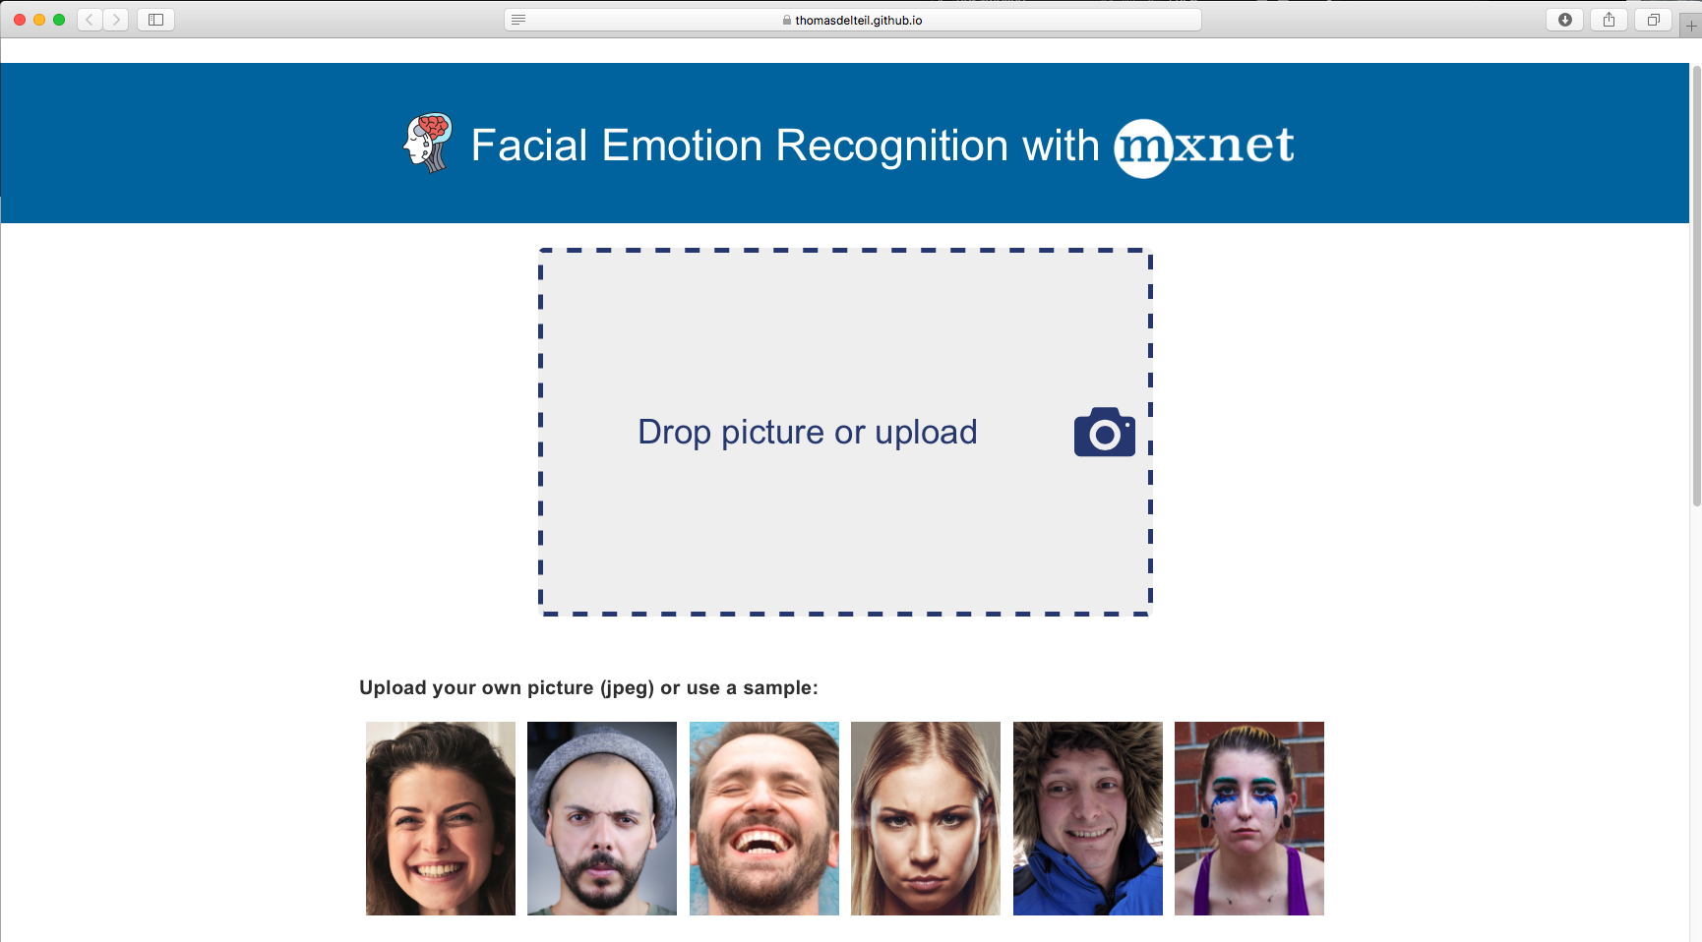
Demo

Slide 27
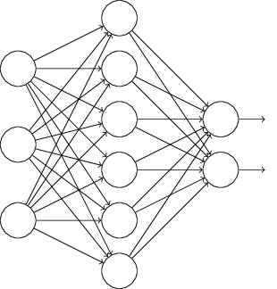
So what does a deployed model looks like?
Model
Mobile
Internet
Model Server
Desktop
IoT
Credits: Hagay Lupesko
Notes:
OK, so hopefully by now you are convinced that Deep Learning is awesome, and the next thing you want to do is use it in your production system.
So, how do you actually use a deep learning model in your production environment?
Let’s start with the outcome we’re trying to achieve. In fact, it is pretty straight-forward, and is not very different than deploying any other service.
We have a trained model, that we want to use for inference,
We have a bunch of clients: mobile, desktop, iot, cloud – or any combination of those
We want to have a server of sorts, hosting a trained model, exposing an inference API, which when called runs a feed forward through the network doing the deep learning “magic” Naveen explained earlier.
That’s a very simple schema of model serving setup.

Slide 28

The Undifferentiated Heavy Lifting of Model Serving
Performance
Networking
Monitoring
Model Decoupling
Cross Framework
Cross Platform
Availability
Model Server for MXNet
Credits: Hagay Lupesko
Notes:
As we saw in the previous slide, in many ways, serving deep learning models is similar to other, more traditional, serving frameworks out there, such as Apache Tomcat. And indeed in many ways, Model Serving is undifferentiated heavy lifting. That is a term we use and focus on in AWS a lot. What it means is all of the aspects that are necessary to get the job done, but that are not differentiating your business, things like setting up servers, networks, etc. is all UHL.
Let’s quickly go over the main concerns Model Serving system needs to address:
- Performance – this concern is about providing a scalable architecture that is able to meet target TPS, making an efficient use of the available compute resources, strike the right balance between throughput and latency. It is especially important for Deep Learning, since the computational load of running a single inference is typically significant. As a reference, a model such as ResNet-152 requires billions of FLOPs for a single forward pass.
Availability – to make your application working properly all the time, you want to minimize down time, and avoid offline status when load is high, or when you are busy deploying a new model.
Networking – making your model consumable means you need to expose a network endpoint that clients can call to get predictions. This endpoint needs to support standard interfaces such as HTTP, error codes, security and more.
Monitoring – having any service in production means you need the ability to look into your operational metrics in near-real time; things like resource utilization on host, inference latencies, requests and errors.
Model Decoupling– when you are serving models you want to offer a way that enables to use trained models without knowing anything about their inner working details. The model may be identifying cats in images, or doing sentiment analysis. No change should be done to the server beyond deploying a different model.
Cross Framework – there are many different Neural Network frameworks: MXNet, TensorFlow, PyTorch, Caffe, and more. “Same Same, But Different” - all similar, but different in style and implementation details. We want a model server that just works, regardless of the framework used to build and train the model.
Cross Platform – similar to how there are many frameworks, there are also many platforms you can run your server on. From the OS (Linux, Windows) to the actual compute processor which can be a CPU, a GPU or a TPU.
And beyond all of that, one uber-concern that is an important meta concern is Ease of Use – all of the concerns just mentioned needs to be addressed in a way that is easy to use, quick to learn, and just work!

Slide 29
Model Archive
Trained Network
Model Signature
Model Archive
Model Export CLI
Custom Code
Auxiliary Assets
Back
Credits: Hagay Lupesko
Notes:
To decouple the actual model from the serving framework, we designed the “Model Archive”.
Model Archive is a file that encapsulates all of the model-specific logic. It is the one-and-only resource MMS needs in order to set up serving for the model. In many ways, it is similar to Java’s JAR file – and indeed we have took a similar implementation approach.
Let’s take a look at what is needed to generate a model archive: a trained neural network, a signature file defining input and output types and shapes, which tells MMS what endpoints to setup, and how to transform the inputs and outputs. Then there’s the option to include custom code, which allows users to add feature extraction logic, or any other init/pre/post processing logic they may want to build into the model. Additionally, users can package whatever other additional files their model will need at runtime. Class labels is an example use case for aux files.
Users use the MMS export CLI to package up all of these assets into a Model Archive package, which is then used by MMS to initialize and serve requests as we’ve seen earlier.
This decoupling enables a clean separation of responsibilities between model creation and model serving. 1. The ML Engineer or Data Scientist build and trains the model, writes feature extraction code, and then packages it all up into the archive.
2. The Software Engineer or Dev Ops Engineer setup up MMS on a prod cluster, and configures MMS to point to the archive, either on the local FS or on a remote URL.
Let’s quickly jump to the console to see how this looks (DEMO)
Show a pre-prepared folder with model, signature, code and aux files
Open the signature and show
Open the code and show
Show how the export utility is used

Slide 30
Containerization
Lightweight virtualization, isolation, runs anywhere
Container Cluster
MMS Container
MMS Container
MMS Container
MXNet Model Server
MXNet
Netty
Pull or Build
Push
Launch
MMS Dockerfile
Back
Credits: Hagay Lupesko
Notes:
As I demoed, you can easily run MMS on your Mac. While this will work well for prototyping or testing, it is not a scalable setup for high-load production traffic. For production deployments we recommend using containers: they are lightweight, provides isolation and have wide platform support. The MMS repo includes Docker images that are pre-configured with required software components and configuration for optimal execution. Users can use this image with their container orchestration tool of choice, and there’s plenty of good options out there such as ECS, Docker and Kubernetes.
Users can pull a pre-built, optimized, docker image, or build one themselves, push it to a registry, and then orchestrate it with a platform such as ECS. ECS manages the cluster, including scaling, load balancing, networking, instrumenting and more. The MMS image itself includes an NGINX network reverse proxy, integrated with MMS.
To learn more about MMS container setup, visit the GitHub repo, where we have details and instructions. We just published a blog post showing how you can setup a serverless MMS container cluster with ECS Fargate - it is pretty cool!

Slide 31
MXNet Model Server
Machine learning model server
Serves MXNet and ONNX models
Automated HTTP endpoints setup
Auto-scales to all available CPUs and GPUs
Pre-built and configured containers
CLI to package model artifacts for serving
Open source project under AWS Labs
https://github.com/awslabs/mxnet-model-server
Credits: Hagay Lupesko
Notes:
Just a bit of background on MXNet:
It is an Apache open source project. People sometimes think it is an “Amazon Project” but it is not. It is truly open source, decisions are made by the community. However, it is true that AWS is contributing a lot to the project.
It is a framework for building, training and using DNNs for inference. Similar to TF, PyTorch, etc.
It originated in the adademia, CMU and UW
Aws adopted MXNet late 2016 as “DL FW of choice), there’s a nice blog post by AWS CTO (Vogels) explaining more in details. A lot of it is about scalability and MXNet being good for production use.

Slide 32
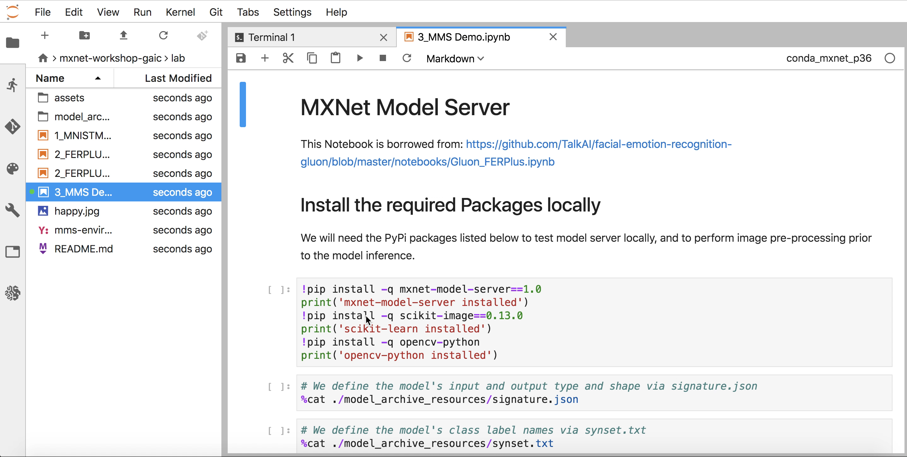
MMS Demo

Slide 33
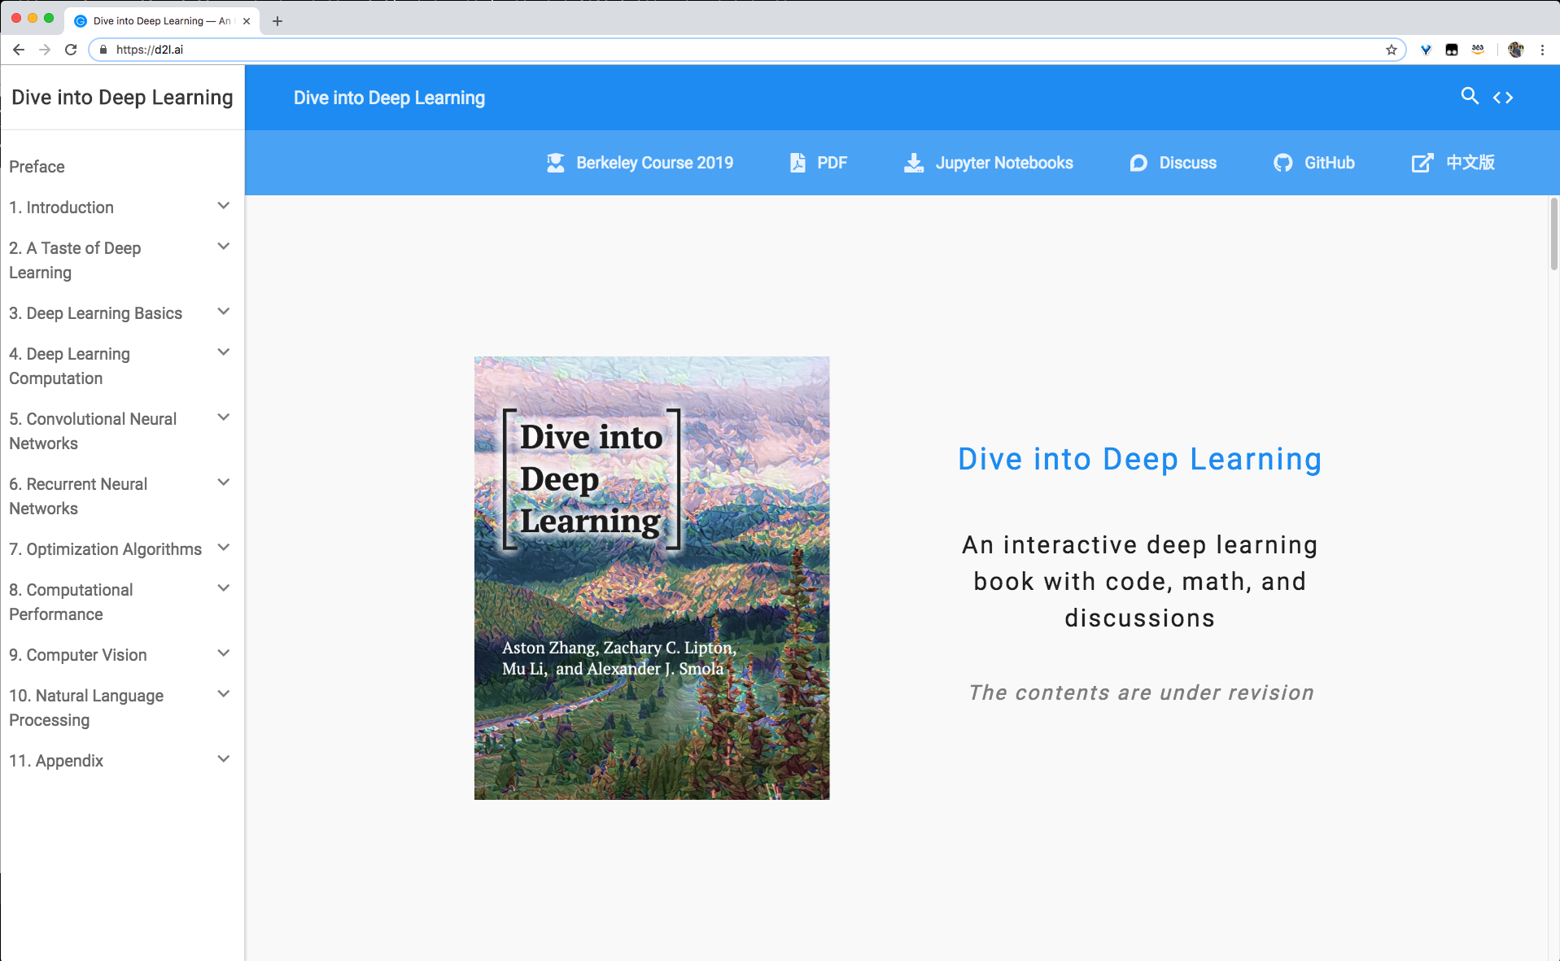
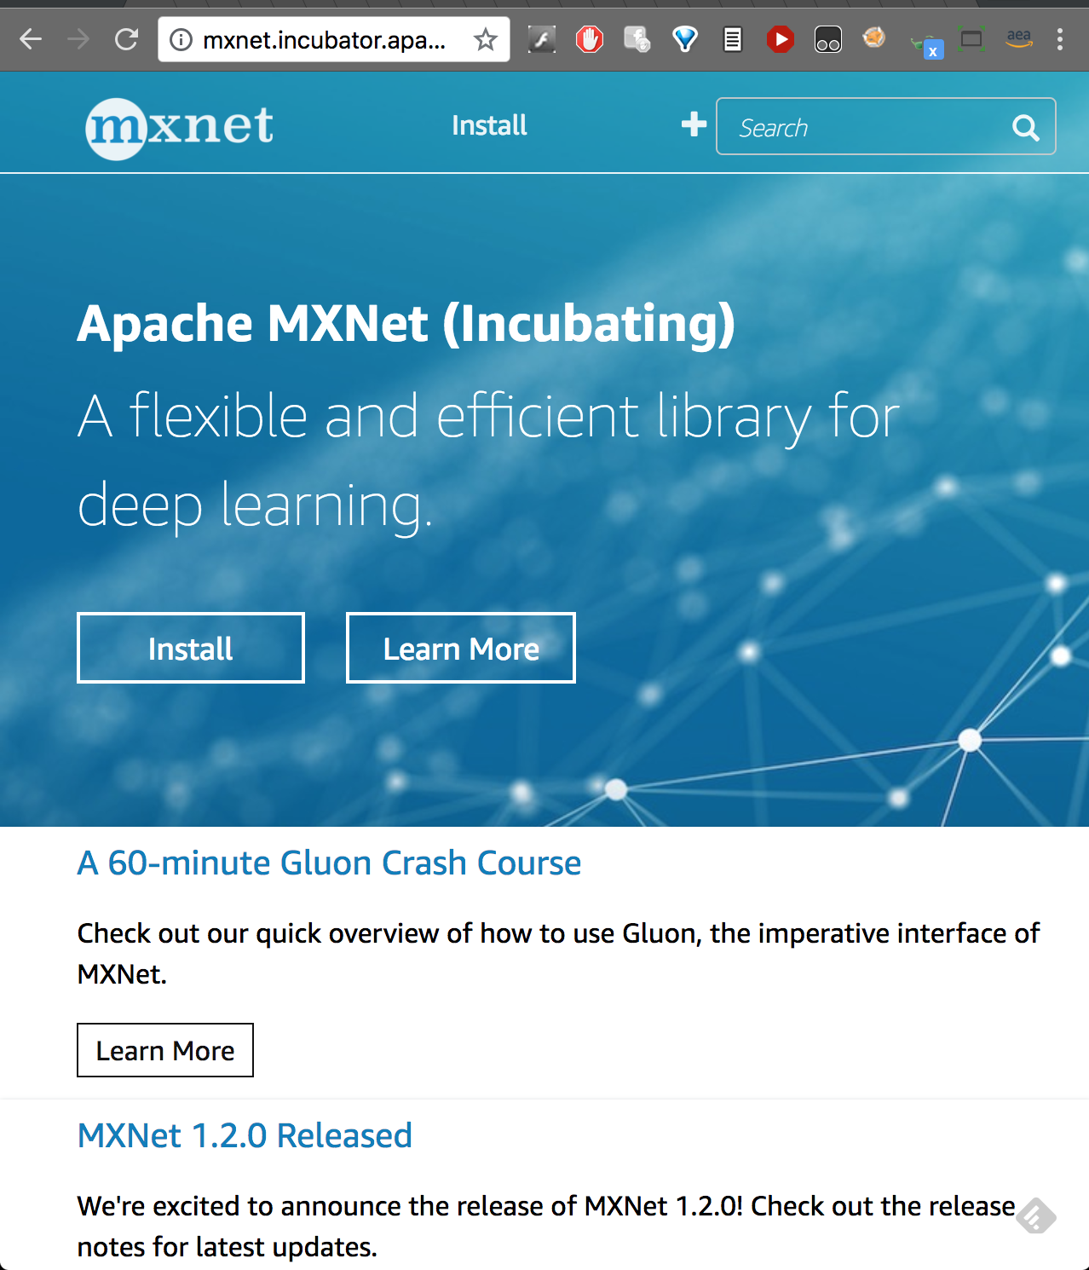
Notes:
Change to an image of d2l

Slide 34
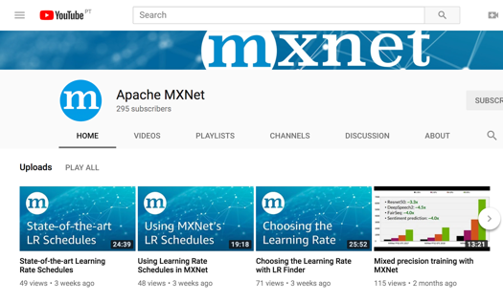

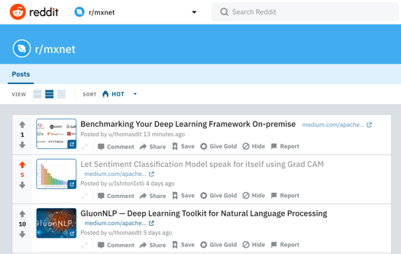
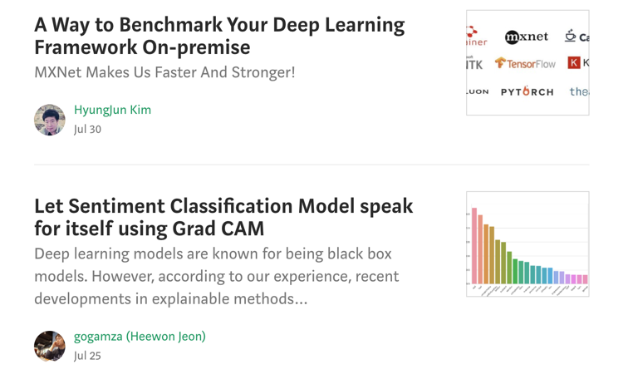
Apache MXNet Social
YouTube: /apachemxnet
Twitter: @apachemxnet
Medium: /apache-mxnet
Reddit: r/mxnet
Notes:
https://www.reddit.com/r/mxnet/

Slide 35
Resources/References
Apache MXNet – Flexible and efficient deep learning.
https://github.com/apache/incubator-mxnet
https://github.com/vandanavk/mxnet-workshop-gaic
Apache MXNet Gluon Tutorials
The Deep Learning Book
MXNet – Using pre-trained models
https://medium.com/apache-mxnet
https://twitter.com/apachemxnet
Notes:
GitHub Repo of MXNet
Blog on this topic.
Code Sample
Gluon has a great set of tutorials to learn deep learning starting from the basics all the way to building a Object Detector on images containing multiple objects.
The Deep Learning Book by Yoshua Bengio and others is great if you want go really get a deep understanding of DL.

Slide 36
Thank You kannanva@amazon.com wamy@amazon.com
Notes:
If you have questions or want to chat more – I’ll be around, so feel free to drop by!

Slide 37
Transfer learning
What?
ML technique where a model trained in one task is used in another task
Why?
Previous knowledge
Saves time
Better performance
How?
Notes:
Add in notebook

Slide 38
DL ⊆ ML ⊆ AI
AI
Machine Learning
Deep Learning
Data
Data
Machine Learning
Traditional Programming
Rules
Answers
Answers
Rules
Notes:
Machine Learning is a collection of algorithmic techniques solving a subset of AI problem.
In traditional programming, you pass Data and Rules and get the answers. For example, you write an addition function, where data is 2 numbers (a, b). And The rule is “+” (addition).
So when you pass 2 numbers to addition program, it knows the rule to compute the answers and return it.
However, when it comes to Machine Learning, you give a bunch of data and answers and you ask the algorithm to figure out the rules. Basically, you ask the computer to “learn” the rules.
Now, Deep Learning. Basically, Deep Learning is a subset of Machine Learning. Deep Learning uses an algorithm technique called ANN (Artificial Neural Networks) to solve AI problems
So you can think DL as a subset of ML specially on Neural Network techniques.

Slide 39
Lab 1 – DL Basics

Slide 40
Facial Emotion Recognition
Notes:
OK, without further ado, let’s see how MMS looks in practice.
We’ll start with the basic use case: installing MMS, loading a model, serving it, and doing prediction.
Ready?
Demo:
Install MMS
Show the model zoo, copy a model link
Download an image
Use cURL to do inference
Examine the results

Slide 41
Problem Statement
XYZ bank wants to improve the customer experience rating. They recognize bank customer care representative is one of the main factor to improve the experience for customers visiting the bank branch offices. XYZ bank decides to analyze the emotion {Happy, Stressed, Tired …} of its customer facing employees in different settings {Time of the day, location, before and after event …} and strategize on –
Happy employees, happy customers!

Slide 42
Stage 1 - Problem Formulation
Scalable solution is to automate.
Capture photos of the customer care representatives and analyze the emotions.
We want a machine to be able to See, learn and classify.
A good problem to be solved with AI using Computer Vision (CV) techniques.
“We want to build a Facial Emotion Recognition model”

Slide 43
Stage 2 – Do I need to build my model?
Model Zoo
Transfer Learning / Fine Tuning
Build the Model
Is the pre-trained model available in Model Zoo - https://github.com/onnx/models, https://gluon-cv.mxnet.io/model_zoo/index.html, http://gluon-nlp.mxnet.io/scripts/index.html
Extend the pre-trained model – Transfer Learning, Fine Tuning?
SOTA
State of the Art Research (SOTA)
Build and Train the model for your problem.

Slide 44
SOTA – FER+
FER+ – Training Deep Networks for Facial Expression Recognition with Crowd-Sourced Label Distribution by Barsoum et. al. https://arxiv.org/pdf/1608.01041.pdf
8 emotion types: {neutral, happiness, surprise, sadness, anger, disgust, fear, and contempt}
Pre-trained model in ONNX model zoo - https://github.com/onnx/models/tree/master/emotion_ferplus
For this talk, transfer learning from a pre-trained model in GluonCV Model Zoo

Slide 45
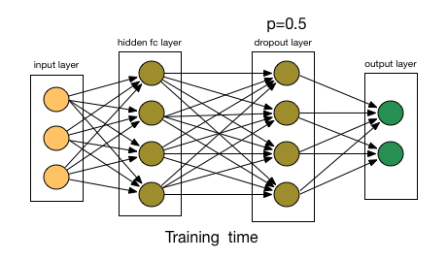
CNN Building Blocks - Dropout

Slide 46
MXNet Gluon – Imperative & Fast
Simple, Easy-to-Understand Code
Neural networks can be defined using simple, clear, concise code
Plug-and-play neural network building blocks – including predefined layers, optimizers, and initializers
Flexible, Imperative Structure
Eliminates rigidity of neural network model definition and brings together the model with the training algorithm
Intuitive, easy-to-debug, familiar code
Dynamic Graphs
Neural networks can change in shape or size during the training process to address advanced use cases where the size of data fed is variable
Important area of innovation in Natural Language Processing (NLP)
High Performance
There is no sacrifice with respect to training speed
When it is time to move from prototyping to production, easily cache neural networks for high performance and a reduced memory footprint
Credits: Cyrus Vahid

Slide 47
GluonCV: a Deep Learning Toolkit for Computer Vision https://gluon-cv.mxnet.io
50+ Pre-trained models, with training scripts, datasets, tutorials

Slide 48
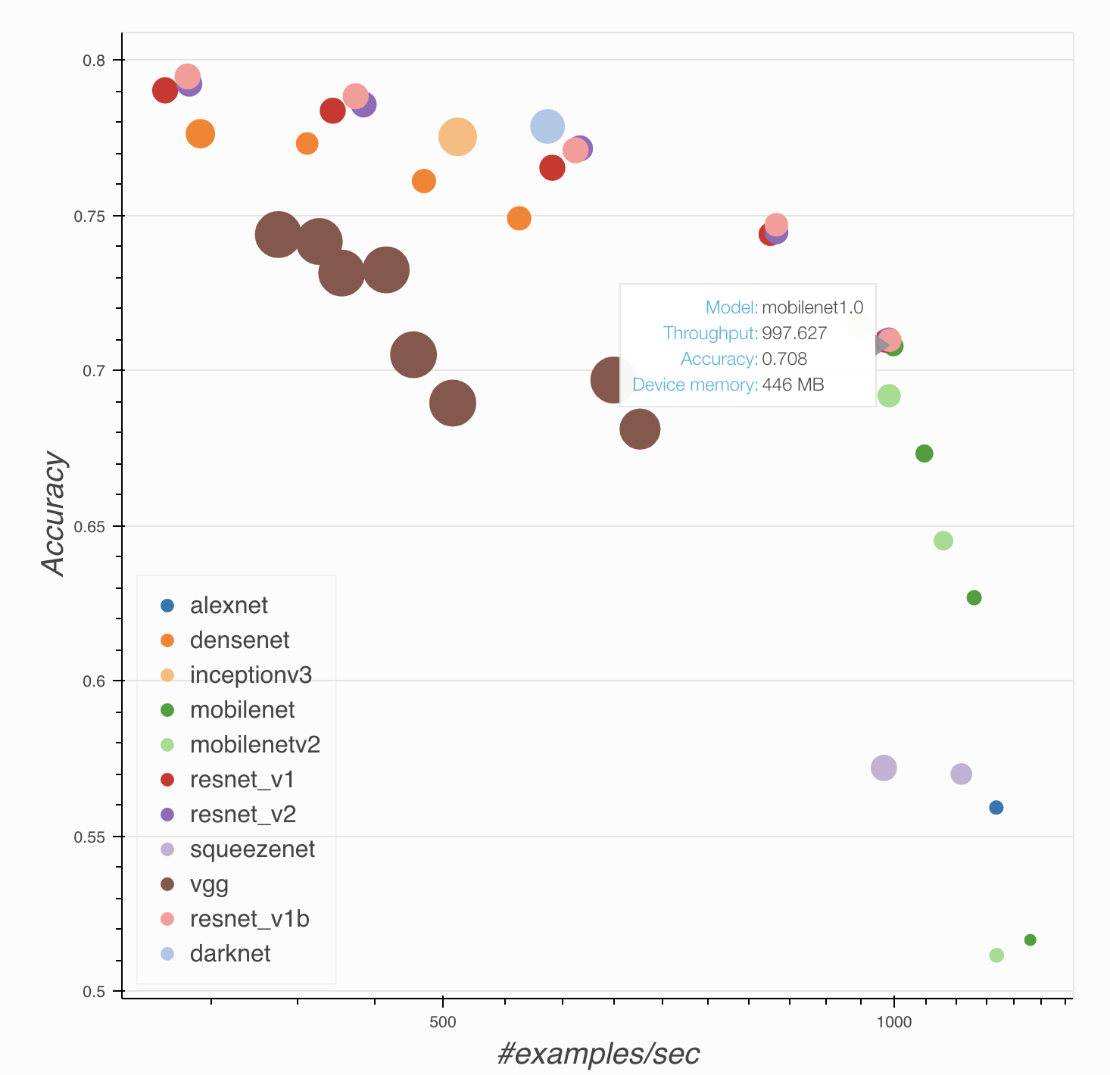
GluonCV: pre-trained models, help to choose

Slide 49
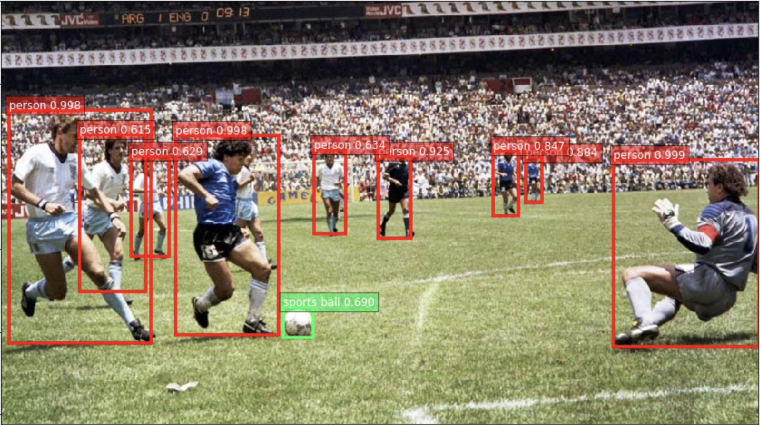
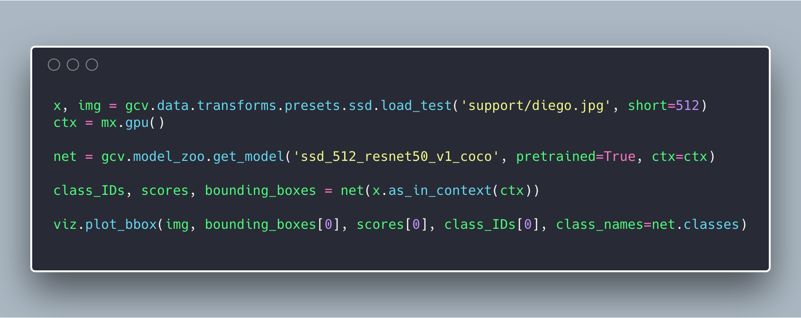
GluonCV: example code

